Slide 1
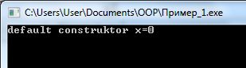
Пример вызова конструктора
class X { protected: int x; public: X(){x=0; cout<<"default construktor"<<" x="<<x<<endl;} X(int i){x=i; cout<<"initial construktor"<<" x="<<x<<endl;} }; int main() { X obj_x; //X obj_x(); //X obj_x(5); }

Slide 2
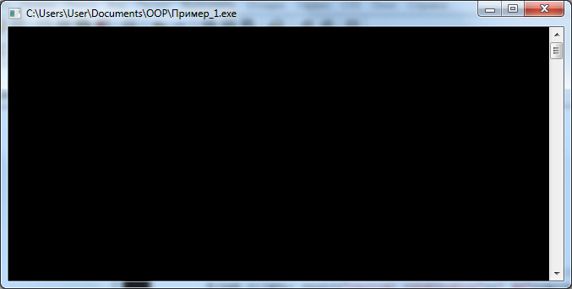
Пример вызова конструктора (продолжение)
class X { protected: int x; public: X(){x=0; cout<<"default construktor"<<" x="<<x<<endl;} X(int i){x=i; cout<<"initial construktor"<<" x="<<x<<endl;} }; int main() { // X obj_x; X obj_x(); //X obj_x(5); }

Slide 3
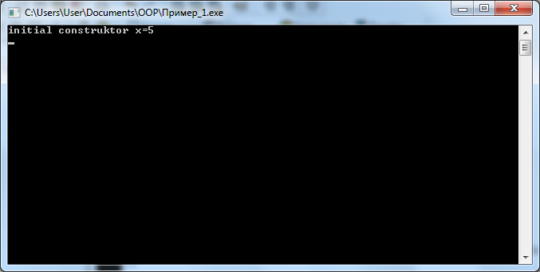
Пример вызова конструктора (продолжение)
class X { protected: int x; public: X(){x=0; cout<<"default construktor"<<" x="<<x<<endl;} X(int i){x=i; cout<<"initial construktor"<<" x="<<x<<endl;} }; int main() { // X obj_x; //X obj_x(); X obj_x(5); }

Slide 4
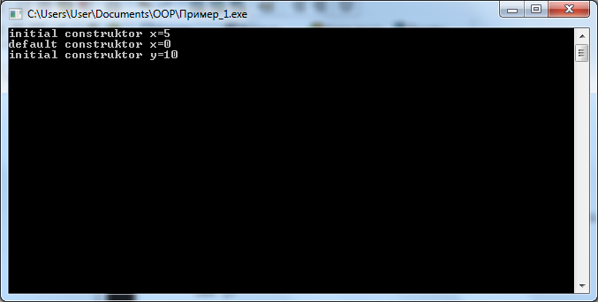
Конструкторы с параметрами при наследовании.
class X { protected: int x; public: X() {x=0; cout<<"default construktor"<<" x="<<x<<endl;} X(int i) {x=i; cout<<"initial construktor"<<" x="<<x<<endl;} }; | class Y: public X { protected: int y; public: Y() {y=0; cout<<"default construktor"<<" y="<<y<<endl;} Y(int j) {y=j; cout<<"initial construktor"<<" y="<<y<<endl;} }; int main() { X obj_x(5); Y obj_y(10); }

Slide 5
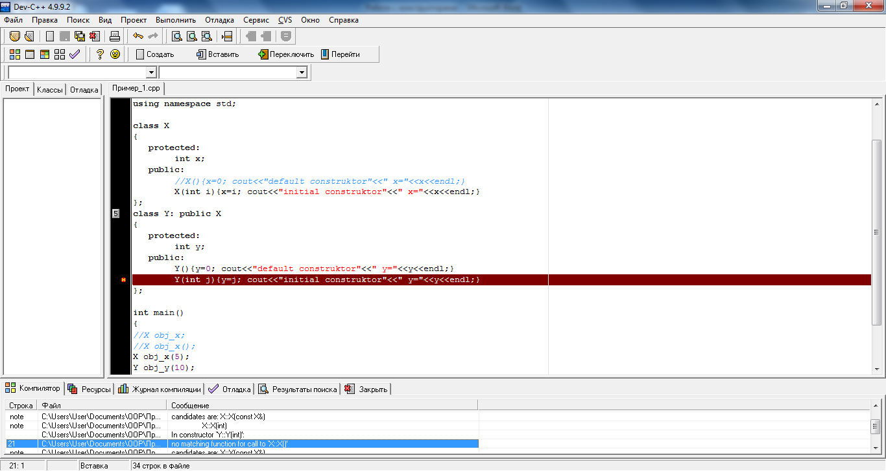
Конструкторы с параметрами при наследовании.
class X { protected: int x; public: //X() {x=0; cout<<"default construktor"<<" x="<<x<<endl;} X(int i) {x=i; cout<<"initial construktor"<<" x="<<x<<endl;} }; | class Y: public X { protected: int y; public: Y() {y=0; cout<<"default construktor"<<" y="<<y<<endl;} Y(int j) {y=j; cout<<"initial construktor"<<" y="<<y<<endl;} }; int main() { X obj_x(5); Y obj_y(10); }

Slide 6
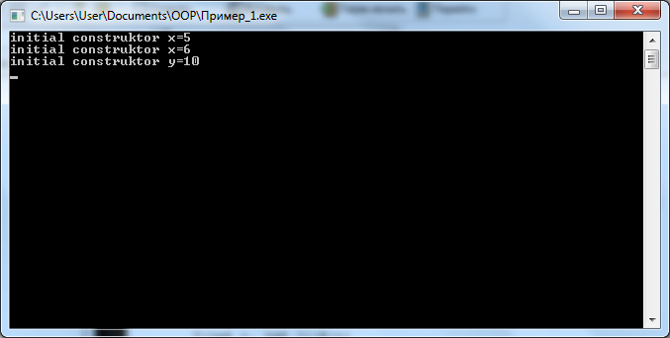
Конструкторы с параметрами при наследовании.
class X { protected: int x; public: X() {x=0; cout<<"default construktor"<<" x="<<x<<endl;} X(int i) {x=i; cout<<"initial construktor"<<" x="<<x<<endl;} }; | class Y: public X { protected: int y; public: Y() {y=0; cout<<"default construktor"<<" y="<<y<<endl;} int main() { X obj_x(5); Y obj_y(6,10); }
Y(int i, int j):X(i)
{y=j; cout<<"initial construktor"<<" y="<<y<<endl;} };
Y(int j) {y=j; cout<<"initial
construktor"<<" y="<<y<<endl;}

Slide 7
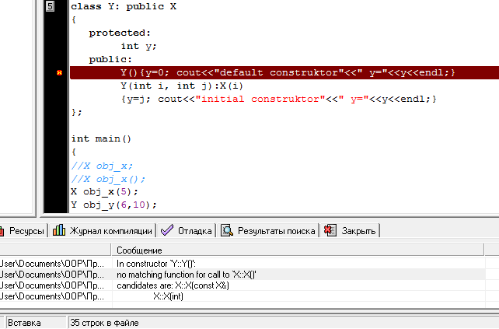
Конструкторы с параметрами при наследовании.
class X { protected: int x; public: //X() {x=0; cout<<"default construktor"<<" x="<<x<<endl;} X(int i) {x=i; cout<<"initial construktor"<<" x="<<x<<endl;} }; | class Y: public X { protected: int y; public: Y() {y=0; cout<<"default construktor"<<" y="<<y<<endl;} Y(int i, int j):X(i) {y=j; cout<<"initial construktor"<<" y="<<y<<endl;} }; int main() { X obj_x(5); Y obj_y(6,10); }

Slide 8
Конструкторы с параметрами при наследовании.
class X { protected: int x; public: //X() {x=0; cout<<"default construktor"<<" x="<<x<<endl;} X(int i) {x=i; cout<<"initial construktor"<<" x="<<x<<endl;} }; | class Y: public X { protected: int y; public: // Y() {y=0; cout<<"default construktor"<<" y="<<y<<endl;} Y(int i, int j):X(i) {y=j; cout<<"initial construktor"<<" y="<<y<<endl;} }; int main() { X obj_x(5); Y obj_y(6,10); }

Slide 9
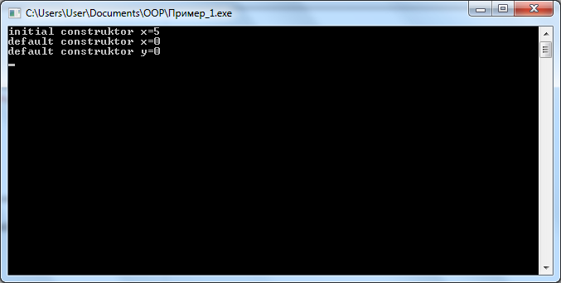
Конструкторы с параметрами при наследовании.
class X { protected: int x; public: X() {x=0; cout<<"default construktor"<<" x="<<x<<endl;} X(int i) {x=i; cout<<"initial construktor"<<" x="<<x<<endl;} }; | class Y: public X { protected: int y; public: Y() {y=0; cout<<"default construktor"<<" y="<<y<<endl;} Y(int i, int j):X(i) {y=j; cout<<"initial construktor"<<" y="<<y<<endl;} }; int main() { X obj_x(5); Y obj_y; }

Slide 10
class X
{ protected:
int x;
public:
X() {x=0; cout<<"default construktor"<<" x="<<x<<endl;}
X(int i) {x=i; cout<<"initial construktor"<<" x="<<x<<endl;}
};
class X
{
protected:
int x;
public:
X():x(0)
{ cout<<"default construktor"<<" x="<<x<<endl; }
X(int i):x(i)
{ cout<<"initial construktor"<<" x="<<x<<endl; }
};

Slide 11
Y(int i, int j): X(i)
{
y=j;
cout<<"initial construktor"<<" y="<<y<<endl;
}
Y(int i, int j):X(i), y(j)
{
cout<<"initial construktor"<<" y="<<y<<endl;
}

